Slide 1
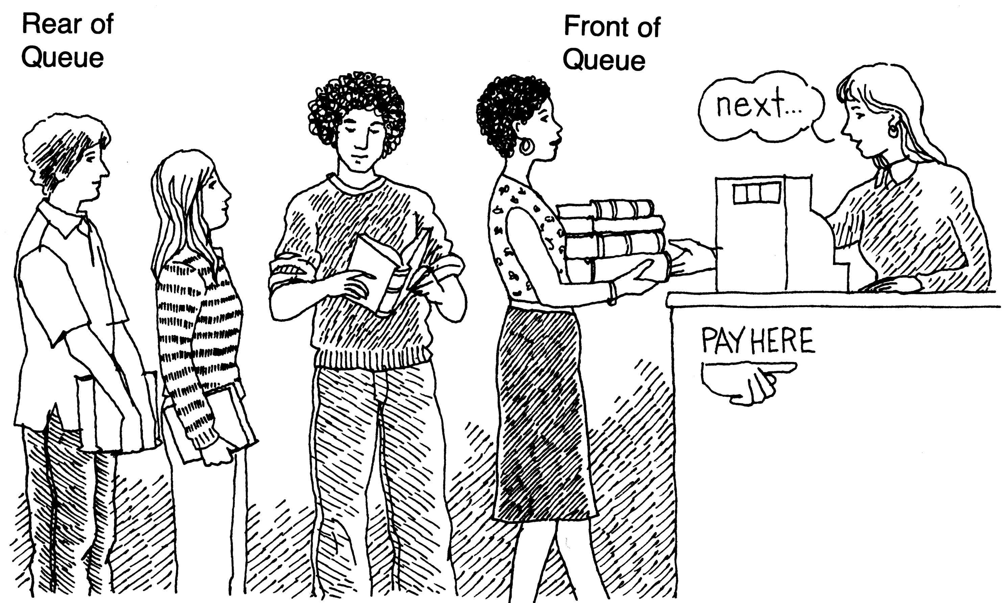
Queues

Slide 2
What is a queue?
A queue is a particular kind of abstract data type or collection in which the entities in the collection are kept in order and the principal (or only) operations on the collection are the addition of entities to the rear terminal position and removal of entities from the front terminal position. This makes the queue a First-In-First-Out (FIFO) data structure.

Slide 3
What is a queue? (cont)
Simply put, a queue is a linear list in which the items are deleted in the same order in which they were inserted.
An example is a waiting line or queue for a bus.
In a FIFO data structure, the first element added to the queue will be the first one to be removed. This is equivalent to the requirement that once an element is added, all elements that were added before have to be removed before the new element can be invoked.

Slide 4
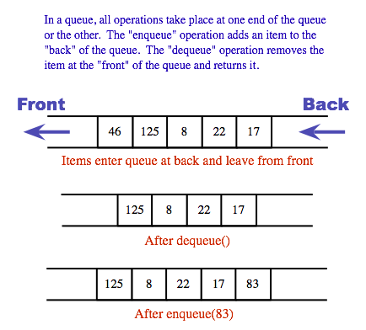
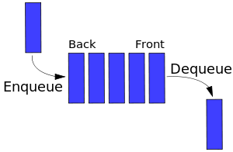

Slide 5
Representing a queue
In each of the cases, the customer or object at the front of the line was the first one to enter, while at the end of the line is the last to have entered.
Every time a customer leaves, he leaves the queue from the front. This represents the queue “dequeue” function.
Every time another object or customer enters the line to wait, they join the end of the line and represent the “enqueue” function.
The queue “size” function would return the length of the line, and the “empty” function would return true only if there was nothing in the line.

Slide 6
Some Operations on Queues
enqueue(e): Insert element e at the rear of the queue.
dequeue(): Remove element at the front of the queue; an error occurs if the queue is empty. empty(): Return true if the queue is empty and false otherwise.
size(): Return the number of elements in the queue.
empty(): Return true if the queue is empty and false otherwise.
push(e): Enqueue e at the rear of the queue.
pop(): Dequeue the element at the front of the queue.
front(): Return a reference to the element at the queue’s front.
back(): Return a reference to the element at the queue’s rear.

Slide 7
Operation Output front ←Q←rear
enqueue(5) – (5)
enqueue(3) – (5,3)
front() 5 (5,3)
size() 2 (5,3)
dequeue() – (3)
enqueue(7) – (3,7)
dequeue() – (7)
front() 7 (7)
dequeue() – ()
dequeue() “error” ()
empty() true ()

Slide 8
Enqueue (ItemType newItem)
Function: Adds newItem to the rear of the queue.
Preconditions: Queue has been initialized and is not full.
Postconditions: newItem is at rear of queue.

Slide 9
Queue overflow
The condition resulting from trying to add an element onto a full queue.
if(!q.IsFull())
q.Enqueue(item);

Slide 10
Dequeue (ItemType& item)
Function: Removes front item from queue and returns it in item.
Preconditions: Queue has been initialized and is not empty.
Postconditions: Front element has been removed from queue and item is a copy of removed element.

Slide 11
Queue underflow
The condition resulting from trying to remove an element from an empty queue.
if(!q.IsEmpty())
q.Dequeue(item);

Slide 12
Implementing a queue
Theoretically, one characteristic of a queue is that it does not have a specific capacity. Regardless of how many elements are already contained, a new element can always be added. It can also be empty, at which point removing an element will be impossible until a new element has been added again.

Slide 13
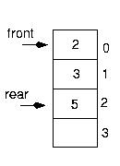
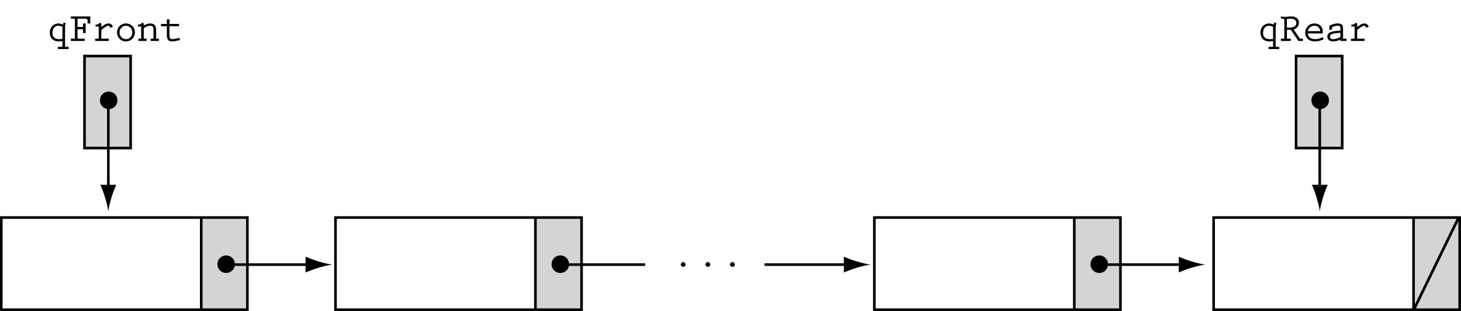
Implementing a queue
O(1)
Array-based
Arrased
Linked-list-based

Slide 14
Implementation of a queue (cont)
An array and two pointers; F (Front pointer: usually pointing one location ahead of the next element to be serviced or deleted - “the element at the front of the queue”) and R ( Rear pointer: pointing to the last item that was inserted into the list) can be used to implement a queue.

Slide 15
Implementation of a queue (cont)
N
N-1
3
2
1
empty
F,R
F=R=0
N
N-1
3
2
1
2 items in
F
R

Slide 16
Implementation of a queue (cont)
N
N-1
3
2
1
Full
(overflow)
F
R
N
N-1
3
2
1
Not full but overflow
R
F

Slide 17
Implementation of a queue (cont)
N
N-1
3
2
1
neither
(overflow nor underflow)
R
F
N
N-1
3
2
1
Empty
(underflow)
R
F
F=R≠ 0 (Space in front of the pointers is just wasted)

Slide 18
Insertion Algorithm
R = R+1;
If R>N then
  overflow, stop
  Else
  X(R) = data_item
  End if

Slide 19
Deletion Algorithm
If F = R then
underflow, stop
Else
F = F + 1
data_item = X(F)
End if

Slide 20
Implementation of a queue (cont)
As items are added and removed from the queue, F follows R. This implementation leads to waste of storage as the size of the array must be as large as the total number of items to be serviced (fixed length array) even though at any instant, fewer items could be in the queue. Items thus need to be copied towards the head of the queue as they are deleted (makes the use of fixed length array inefficient).

Slide 21
Introducing Circular Queues
To overcome the above problems, a circular queue (ie. Conceptually bent so that the ends meet) is employed and it size need only be as large as the maximum if the total number of items in the queue at any instant.
If x(1), x(2),… x(N) are the items of the array, then X(1) is made to follow x(N), i.e. when the end of the queue is reached, further insertion items are placed from the beginning of the queue, if there is room

Slide 22
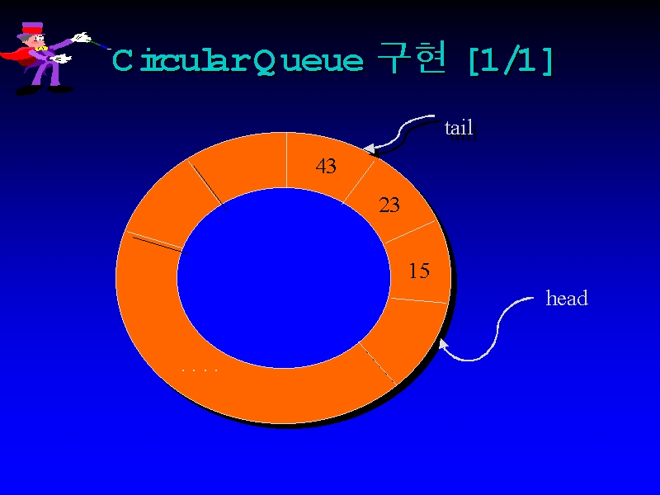

Slide 23
7
N
The queue was filled up completely with N items. (F=R=N). As the items were deleted (items 1-6 deleted) however blanks slots were left at the from of the queue. New items were enqueued from the front
1
F
6
2
5
R
4
3

Slide 24
Circular Queues
In this modified representation, if F=R ≠ 0 (empty queue), then it becomes impossible to distinguish between an empty queue and a full queue. This problem is resolved by never filling the queue completely during insertion operations. One space is left unfilled and the queue is said to be filled, thus differentiating between the two conflicting cases. Illustration is presented in the diagrams below

Slide 25
N
The underflow condition
(very different from when the queue is full)
7
1
6
2
5
F
F = R (underflow)
R
4
3

Slide 26
1
F
6
R
2
5
F = R (overflow)
4

Slide 27
N
The overflow condition
One space is left to distinguish it from the underflow
(F ≠ R)
1
F
6
2
R
5
4
3

Slide 28
Insertion Algorithm for Circular Queues
If N=R then
R = 1
Else
R = R + 1
End if
If R = F then (an if-condition ensuring one space is left in the queue)
overflow, stop
Else
X(R) = data_item
End if

Slide 29
Deletion Algorithm for Circular Queues
If F = R then
underflow, stop
End if
If F = N then
F = 1
Else
F = F + 1
End if
Data_item = X(F)

Slide 30
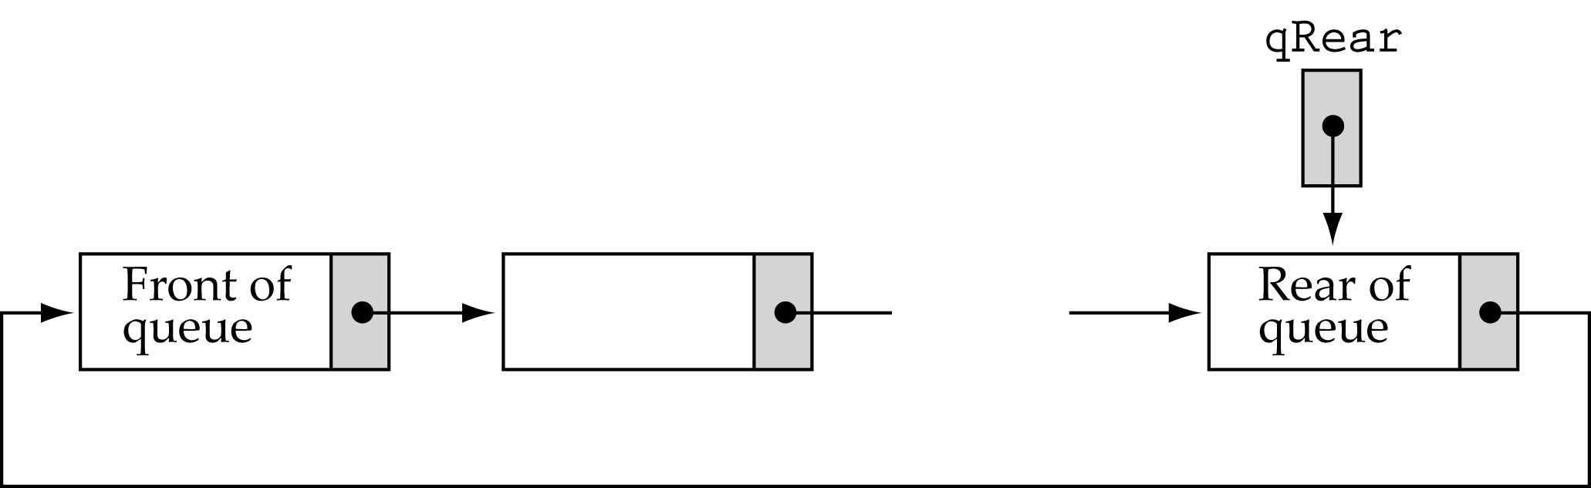
A “circular” linked queue design

Slide 31
A “circular” linked queue design (cont)
CircleList maintains a pointer, called the cursor, which points to one node of the list. Also CircleList provides two member functions, back and front. The function back returns a reference to the element to which the cursor points, and the function front returns a reference to the element that immediately follows it in the circular list.
In order to implement a queue, the element referenced by back will be the rear of the queue (The cursor points to the back of the queue) and the element referenced by front will be the front.
Also CircleList supports the following modifier functions. The function add inserts a new node just after the cursor, the function remove removes the node immediately following the cursor (The front of the queue), and the function advance moves the cursor forward to the next node of the circular list.

Slide 32
Enqueue in “circular” linked queue design
In order to implement the queue operation enqueue, we first invoke the function add, which inserts a new element just after the cursor, that is, just after the rear of the queue. We then invoke advance, which advances the cursor to this new element, thus making the new node the rear of the queue. The process is illustrated in the diagram below

Slide 34
Dequeue in “circular” linked queue design
In order to implement the queue operation dequeue, we invoke the function remove, thus removing the node just after the cursor, that is, the front of the queue.
The process is illustrated

Slide 36
Application of Queues
To speed input/output, records are read/written in advance and held in I/O buffers on a FIFO basis before they are sent to memory, before subsequent processing or written to the external storage device.
Queues are useful in managing tasks or jobs waiting to be executed or are currently executed when service is requested on FIFP basis

Slide 37
Double Ended Queues (Deque)
A double ended queue or deque ( usually pronounced “deck” to avoid confusion with the dequeue function of the regular queue ADT, is a queue in which items can be added or removed from either end. That is to say it supports insertion and deletion at both the front and the rear of the queue.

Slide 38
Some operation on Deque ADT
insertFront(e): Insert a new element e at the beginning of the deque.
insertBack(e): Insert a new element e at the end of the deque.
eraseFront(): Remove the first element of the deque; an error occurs if the deque is empty.
eraseBack(): Remove the last element of the deque; an error occurs if the deque is empty.
Additionally, the deque includes the following support functions:
front(): Return the first element of the deque; an error occurs if the deque is empty.
back(): Return the last element of the deque; an error occurs if the deque is empty.
size(): Return the number of elements of the deque.
empty(): Return true if the deque is empty and false otherwise.

